Slide 1
Picture by Petr Kratochvil
Picture by Petr Kratochvil

Slide 2
(1)
(3)
(2)
(4)
Robin Hake¹, Michel Bürgel¹, Ninh K. Nguyen¹,
Alinka Greasley², Daniel Müllensiefen^{3,4} & Kai Siedenburg¹
Picture by Petr Kratochvil

Slide 3
Auditory Scene Analysis (ASA)
“Auditory scene analysis is the process by which the auditory system separates the individual sounds in natural-world situations…” (Bregman, 1990, MIT Press)

Slide 4
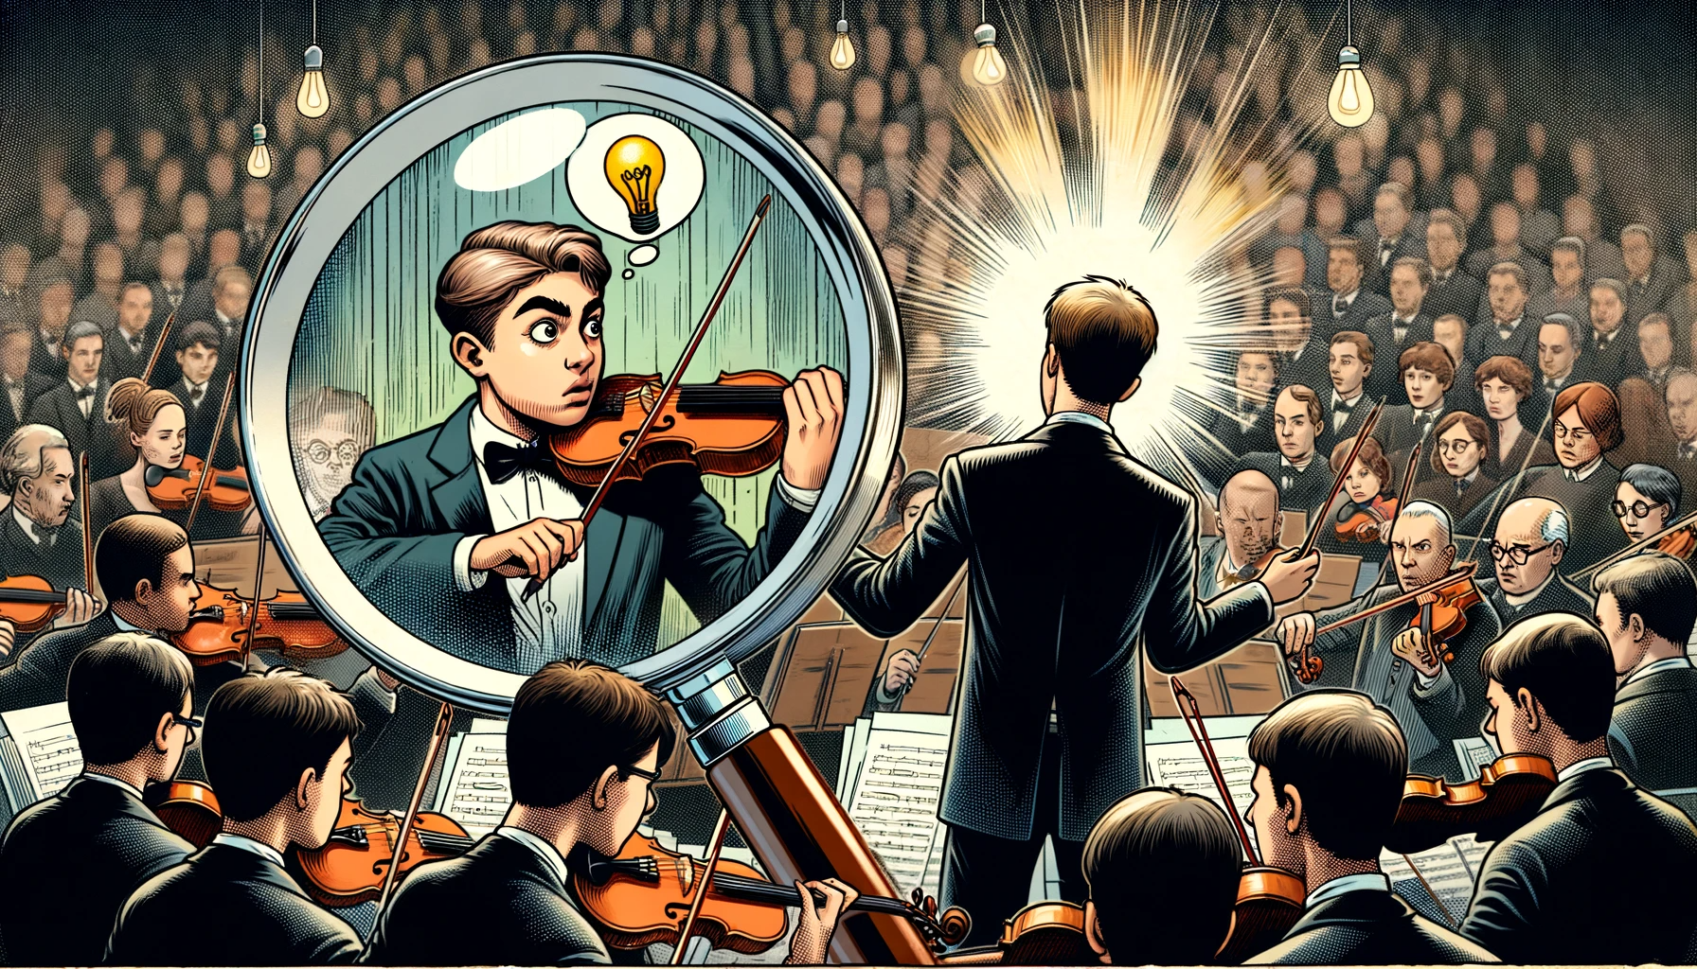
Auditory Scene Analysis (ASA)

Slide 5
Auditory Scene Analysis (ASA)

Slide 6
Auditory Scene Analysis (ASA)
The objective:
the establishment of an adaptive and ecologically valid computer-driven measurement instrument, which is suitable for measuring musical ASA abilities of individuals with a wide range of abilities.
that is, for normal-hearing and hearing-impaired individuals.

Slide 7
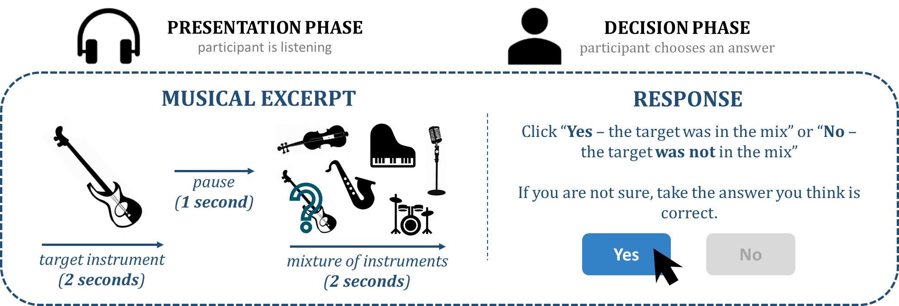
The Procedure
The Musical Scene Analysis Test (MSA)
[Hake, Bürgel, Nguyen, Greasley, Müllensiefen & Siedenburg, 2023; PsyArXiv pre-print]

Slide 8
The Procedure
In order to tailor the difficulty of the test to participants with different abilities, the excerpts varied in terms of...
… the choice of the target instrument (lead-voice, guitar, bass, piano)
… number of instruments in the mixture (3 vs. 6 instruments)
… level difference between target instrument and mixture (0, -5, -10, -15 dB)
Anzahl der Instrumente in der Mischung

Slide 9
The Procedure
open-source database "MedleyDB" (see Bittner et al., 2014; 2016)
comprises recorded real-world multitrack music excerpts representing a range of popular music genres (e.g., classical, rock, jazz, pop, rap)
in total, 160 excerpts from 98 different songs were extracted

Slide 10
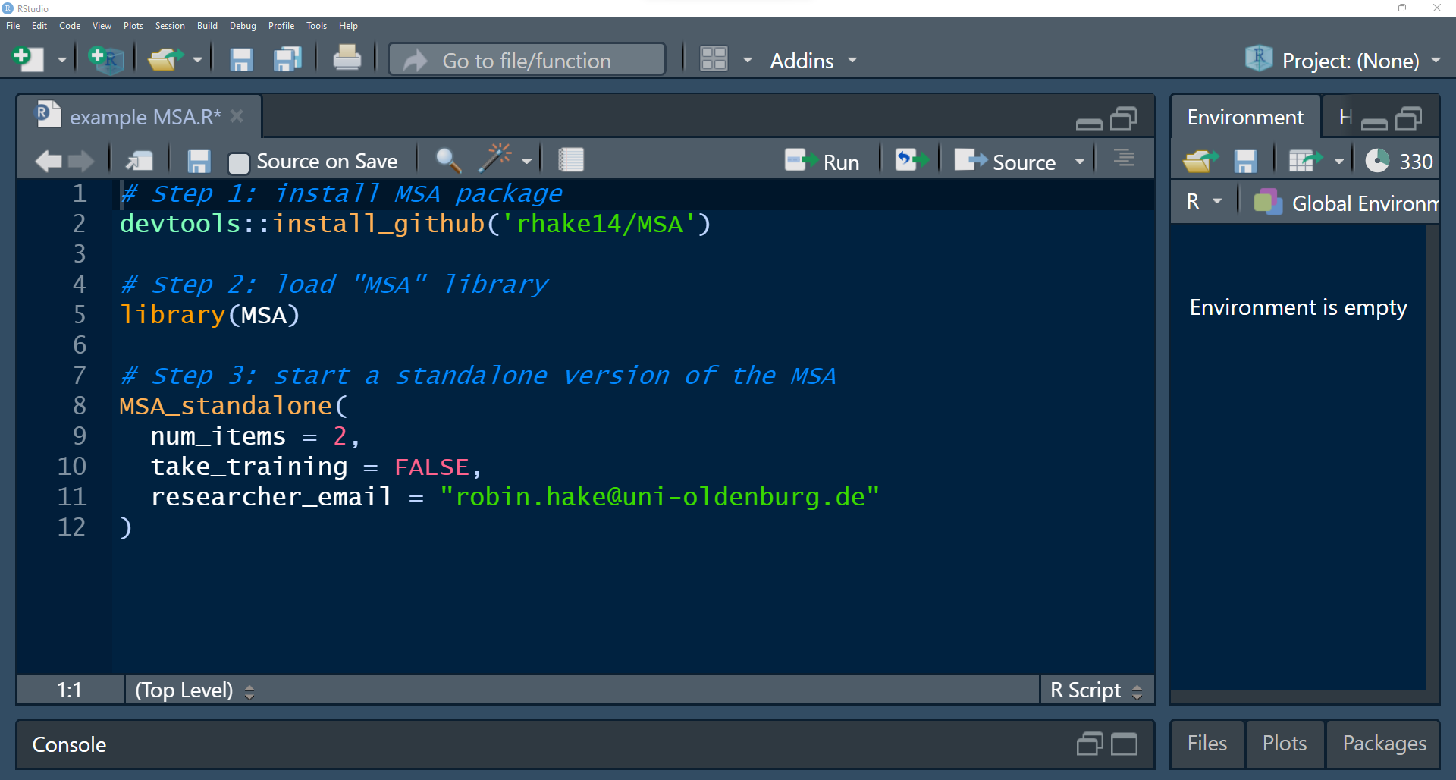

Slide 11
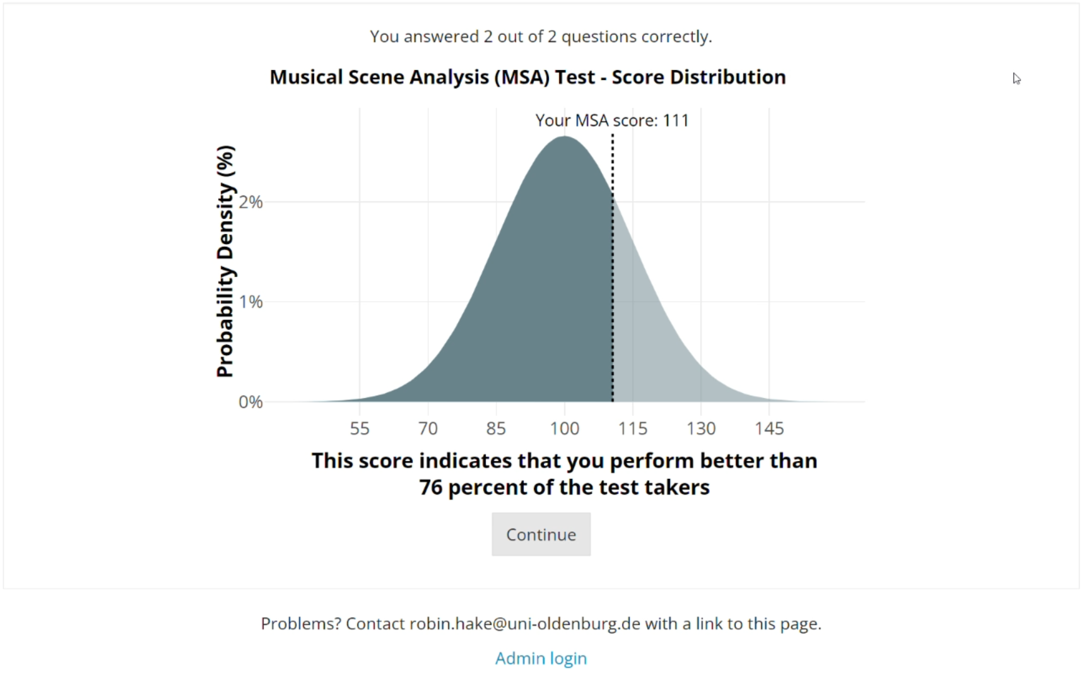

Slide 12
Adaptive MSA test
#1 Calibration:
results from 525 NH and 132 HI listeners (online participation) indicate that all three parameters are all suitable factors to discriminate between listeners’ abilities
#2 Bayesian Item-Response Model
provides estimates for each item’s difficulty and discrimination; & estimates for the guessing and inattention parameters
[brms package R]

Slide 13
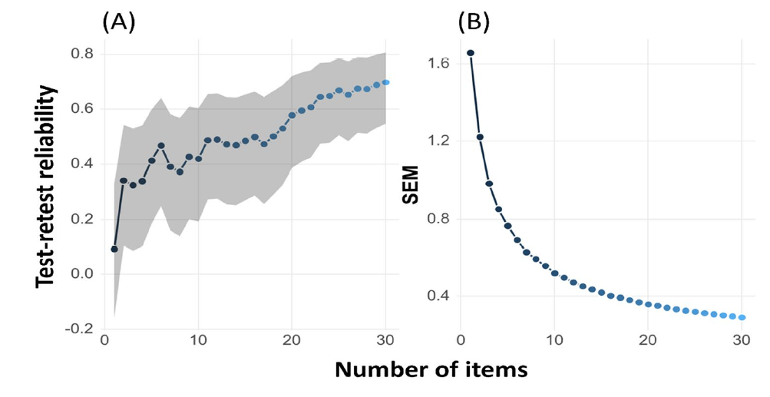
Adaptive MSA test
#3 Validation
50 NH and 20 HI listeners invited (in-lab participation)

Slide 14
Hands-on application
Auditory Scene Analysis (ASA)

Slide 15
Individual
Differences

Slide 16
Previous work

Slide 17
Hearing impairment
timbre identification [Emiroglu & Kollmeier, 2008; Siedenburg et al., 2020]
rhythm perception, pitch discrimination [Uys & van Dijk, 2011]
melodic perception [Kirchberger & Russo, 2015; Siedenburg et al., 2020]
auditory scene analysis [Bayat et al., 2013]

Slide 18
Age
loss of synapses and auditory nerve fibers [e.g., Libermann et al., 2017]
general reduction in the density of connections in the brainstem and cortical structures [e.g., Ouda et al., 2015; Gordon-Salant et al.,2020]

Slide 19
Cognition
age-related/associated cognitive declines [e.g., Garami et al., 2020; Goossens et al., 2017; Gordon-Salant & Cole, 2016; Vinay et al., 2020]
decline in ‘fluid intelligence’ (processing speed) [e.g., Fisher et al., 2019]

Slide 20
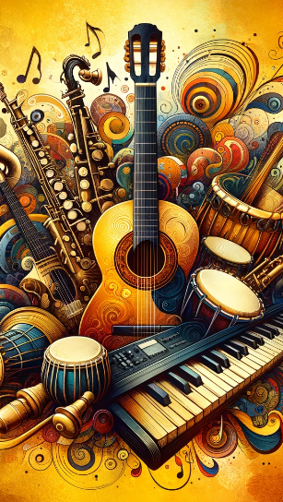
Musical training / sophistication
inconclusive influence on speech-in-noise perception [Madsen et al., 2019; McKay, 2021; Coffey et al., 2017]
positive link with musical-related auditory abilities [Madsen et al., 2019; Siedenburg et al., 2020; von Berg et al., 2021; Zendel & Alain, 2012]
musicians outperform non-musicians in basic cognitive tasks [Herholz & Zatorre, 2012; Talamini et al., 2017]

Slide 21
Procedure
Musical Scene Analysis Test (adaptive with 30 items) [Hake et al., 2023]
Individual
Differences

Slide 22
Procedure
Musical Scene Analysis Test (adaptive with 30 items) [Hake et al., 2023]
Individual
Differences
better-ear audiometry (pure-tone average; PTA)

Slide 23
Procedure
Musical Scene Analysis Test (adaptive with 30 items) [Hake et al., 2023]
survey (age, gender etc.)
Individual
Differences
better-ear audiometry (pure-tone average; PTA)

Slide 24
Procedure
Musical Scene Analysis Test (adaptive with 30 items) [Hake et al., 2023]
survey (age, gender etc.)
Individual
Differences
better-ear audiometry (pure-tone average; PTA)
GOLD-MSI musical sophistication [Müllensiefen et al., 2014]

Slide 25
Procedure
Musical Scene Analysis Test (adaptive with 30 items) [Hake et al., 2023]
survey (age, gender etc.)
backward digit span test [e.g., Talamini et al.,
2017; Weiss et al., 2016]
Individual
Differences
better-ear audiometry (pure-tone average; PTA)
GOLD-MSI musical sophistication [Müllensiefen et al., 2014]

Slide 26
Participants
actual data
31 oNH (M = 62.3 years; SD = 7.3)
34 oHI (M = 67.8 years; SD = 7.3)
26 yNH (M = 25.3 years; SD = 4.1)
1 yHI (M = 26 years)
pure tone average [hearing thresholds] dB HL

Slide 27
Results – MSA
***
**

Slide 28
The adaptive MSA test
suitable for young normal-hearing musicians as well as older hearing-impaired non-musicians
ecological valid with realistic stimuli
quick to administer (adaptive)
flexibility with adjustable test length
user-friendly
enjoyable
easy-to-implement
open-source
and freely available

Slide 29
THE MSA TEST
suitable for young normal-hearing musicians as well as older hearing-impaired non-musicians
ecological valid with realistic stimuli
quick to administer (adaptive)
flexibility with adjustable test length
user-friendly
enjoyable
easy-to-implement
open-source
and freely available

Slide 30
Implications
Hake, R., Bürgel, M., Nguyen, N.K. , Greasley, A., Müllensiefen, D. & Siedenburg, K. (2023). Development of an adaptive test of musical scene analysis abilities for normal-hearing and hearing-impaired listeners. Behavioural Research Methods (2023). https://doi.org/10.3758/s13428-023-02279-y

Slide 31
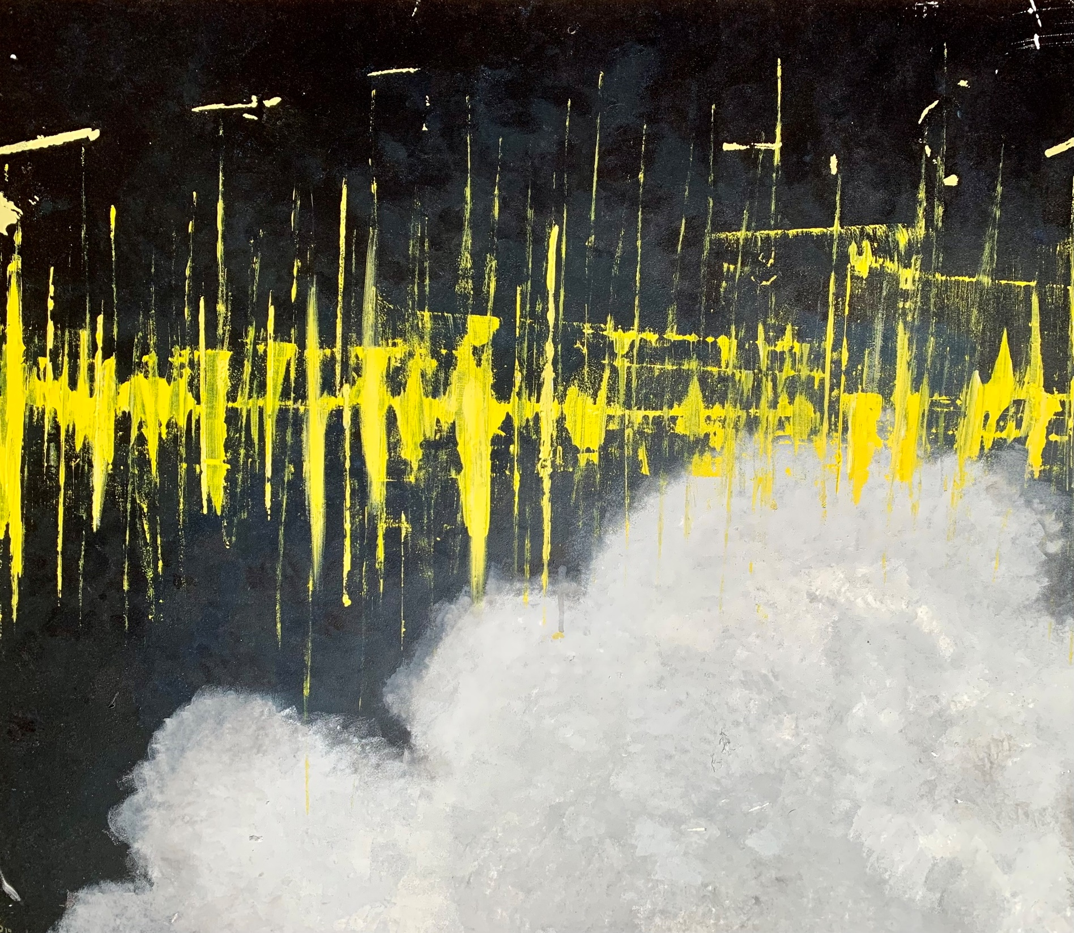
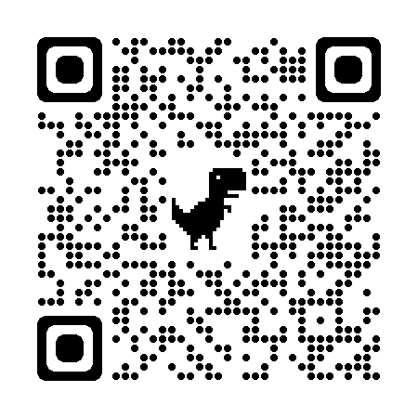
Thank you for your attention!
MSA is now available
Questions?
https://github.com/rhake14/MSA
e-mail: robin.hake@uni-oldenburg.de

Slide 32
References I
Bittner, R., Salamon, J., Tierney, M., Mauch, M., Cannam, C., & Bello, J. P. (2014). MedleyDB: A Multitrack Dataset for Annotation-Intensive MIR Research. In 15th International Society for Music Information Retrieval Conference, Taipei, Taiwan.
Bittner, R., Wilkins, J., Yip, H., & Bello, J. (2016). MedleyDB 2.0: New Data and a System for Sustainable Data Collection. International Conference on Music Information Retrieval (ISMIR-16), New York, NY, USA.
Bregman, A. (1990). Auditory Scene Analysis. Cambridge, MA: MIT Press.
Cramer, E. M., & Huggins, W. H. (1958). Creation of Pitch through Binaural Interaction. Journal of the Acoustical Society of America. https://doi.org/10.1121/1.1909628
Coffey, E. B. J., Mogilever, N. B., & Zatorre, R. J. (2017). Speech-in-noise perception in musicians: A review. Hearing Research, 352, 49–69. https://doi.org/10.1016/j.heares.2017.02.006
Emiroglu, S., & Kollmeier, B. (2008). Timbre discrimination in normal-hearing and hearing-impaired listeners under different noise conditions. Brain Research, 1220, 199–207. https://doi.org/10.1016/j.brainres.2007.08.067
Fisher, G. G., Chacon, M., & Chaffee, D. S. (2019). Theories of cognitive aging and work. In B. B. Baltes, C. W. Rudolph, & H. Zacher (Eds.), Work Across the Lifespan (pp. 17–45). Academic Press. https://doi.org/10.1016/B978-0-12-812756-8.00002-4
Garami, L., Chow, R., Fakuade, A., Swaminathan, S., & Alain, C. (2020). Orienting Attention to Auditory and Visual Short-term Memory: The Roles of Age, Hearing Loss, and Cognitive Status. Experimental Aging Research, 46(1), 22–38. https://doi.org/10.1080/0361073X.2019.1693008
Goossens, T., Vercammen, C., Wouters, J., & van Wieringen, A. (2017). Masked speech perception across the adult lifespan: Impact of age and hearing impairment. Hearing Research, 344, 109–124. https://doi.org/10.1016/j.heares.2016.11.004

Slide 33
References II
Gordon-Salant, S., & Cole, S. S., (2016). Effects of Age and Working Memory Capacity on Speech Recognition Performance in Noise Among Listeners With Normal Hearing. Ear Hear, 37(5):593-602. doi: 10.1097/AUD.0000000000000316
Gordon-Salant, S., Shader, M. J., & Wingfield, A. (2020). Age-related changes in speech understanding: Peripheral versus cognitive influences. In K. S. Helfer, E. L. Bartlett, A. N. Popper, & R. R. Fay (Eds.), Aging and Hearing: Causes and Consequences (pp. 199–230). Springer International Publishing. https://doi.org/10.1007/978-3-030-16073-9_8
Harrison, P. M. C., Collins, T., & Müllensiefen, D. (2017). Applying modern psychometric techniques to melodic discrimination testing: Item response theory, computerised adaptive testing, and automatic item generation. Scientific Reports, 7(1), 1–18. https://doi.org/10.1038/s41598-017-03586-z
Herholz, S. C., and Zatorre, R. J. (2012). “Musical training as a framework for brain plasticity: Behavior, function, and structure,” Neuron 76(3), 486–502.
Kirchberger, M. J., & Russo, F. A. (2015). Development of the adaptive music perception test. Ear and Hearing, 36(2), 217–228. https://doi.org/10.1097/AUD.0000000000000112
Larrouy-Maestri, P., Harrison, P. M. C., & Müllensiefen, D. (2019). The mistuning perception test: A new measurement instrument. Behavior Research Methods, 51(2), 663–675. https://doi.org/10.3758/s13428-019-01225-1
Liberman, M. C., & Kujawa, S. G. (2017). Cochlear synaptopathy in acquired sensorineural hearing loss: Manifestations and mechanisms. Hearing Research, 349, 138–147. https://doi.org/10.1016/j.heares.2017.01.003
Madsen, S. M. K., Marschall, M., Dau, T., & Oxenham, A. J. (2019). Speech perception is similar for musicians and non-musicians across a wide range of conditions. Scientific Reports, 9(1), 1–10. https://doi.org/10.1038/s41598-019-46728-1

Slide 34
References III
McKay, C. M. (2021). No Evidence That Music Training Benefits Speech Perception in Hearing-Impaired Listeners: A Systematic Review. Trends in Hearing, 25, 233121652098567. https://doi.org/10.1177/2331216520985678
Milne, A. E., Bianco, R., Poole, K. C., Zhao, S., Billig, A. J., Chait, M., & Milne amilne, A. (2020). An online headphone screening test based on dichotic pitch. BioRxiv, 1–31. https://doi.org/10.1101/2020.07.21.214395
Müllensiefen, D., Gingras, B., Musil, J., & Stewart, L. (2014). The musicality of non-musicians: an index for assessing musical sophistication in the general population. PloS one, 9(2), e89642.
Ouda, L., Profant, O., & Syka, J. (2015). Age-related changes in the central auditory system. Cell Tissue Research, 361(1), 337–358. https://doi.org/10.1007/s00441-014-2107-x
Pressnitzer, D. (2011). Auditory scene analysis: the sweet music of ambiguity. Frontiers in Human Neuroscience, 5(October 2015). https://doi.org/10.3389/fnhum.2011.00158
Siedenburg, K., Röttges, S., Wagener, K. C., & Hohmann, V. (2020). Can You Hear Out the Melody? Testing Musical Scene Perception in Young Normal-Hearing and Older Hearing-Impaired Listeners. Trends in Hearing, 24. https://doi.org/10.1177/2331216520945826
Talamini, F., Altoe, G., Carretti, B., and Grassi, M. (2017). “Musicians have better memory than nonmusicians: A meta-analysis,” PLoS One 12(10), e0186773
Vinay, Sandhya, & Moore, B. C. J. (2020). Effect of age, test frequency and level on thresholds for the TEN(HL) test for people with normal hearing. International Journal of Audiology, 59(12), 915–920. https://doi.org/10.1080/14992027.2020.1783584

Slide 35
References IV
von Berg, M., Steffens, J., Weinzierl, S., & Müllensiefen, D. (2021). Assessing room acoustic listening expertise. The Journal of the Acoustical Society of America 150(4), 2539–2548. https://doi.org/10.1121/10.0006574.
Weiss, G. L., Saklofske, H. D., Holdnack, A. J., & Prifitera, A. (2016). WISC-V assessment and interpretation. Elsevier. https:// doi. org/ 10. 1016/ C2012-0- 00415-2
Zendel, B. R., & Alain, C. (2012). Musicians experience less age-related decline in central auditory processing. Psychology and aging, 27(2), 410–417. https://doi.org/10.1037/a0024816

